Slide 1


Slide 2




All the cool kids are chasing the consumer to follow, find & track nearby activity.
There are two sides to the mobile local ecosystem.
Perch powers the business side.

Slide 3
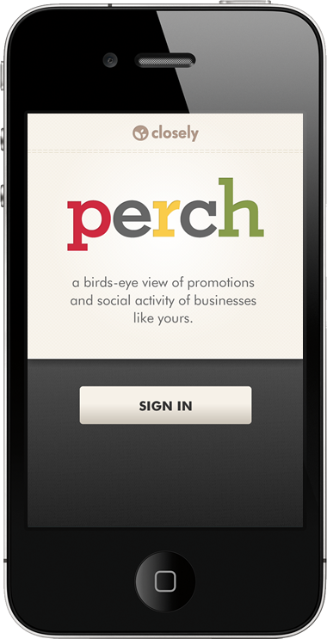
A Bird’s Eye View Of Your Business Neighborhood
What’s going on with:
  Direct Competitors
  Business Neighbors
  Event/Crowd Activity
Live stream of social postings, promotions, deals, check-in specials.
A simple, effective daily tool.

Slide 4
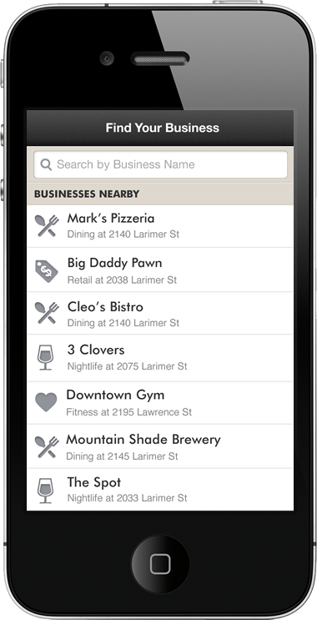
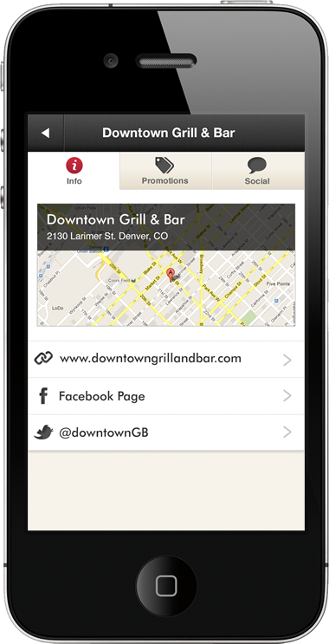
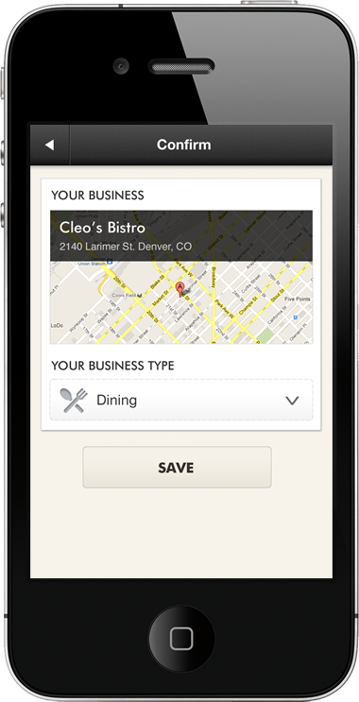
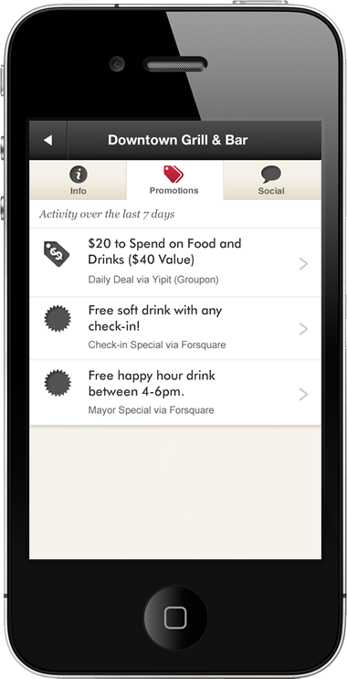
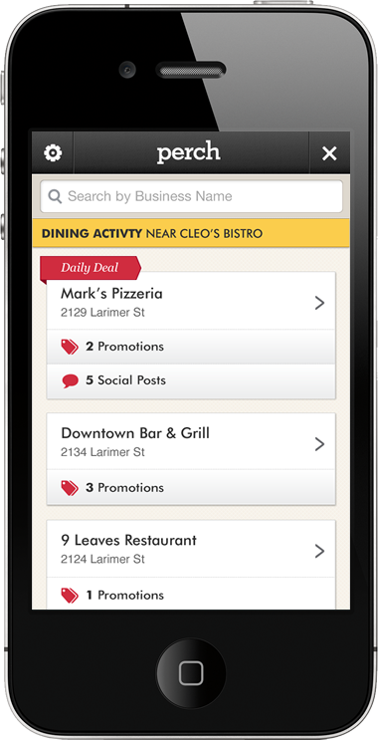
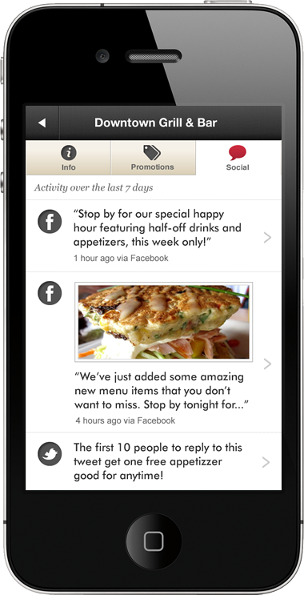

Slide 5
Our proposition.
The ecosystem only scales when small businesses engage.
They’re on the sidelines, confused and overwhelmed.
We deliver their personal local awareness app.
Then, we’ll help them participate.

Slide 6
Private Beta Invitations via
closely.com/perch
Follow us @closely
perry.evans@closely.com

